Slide 1
Typing Dynamics: Change Over Time
STAT 601 Final Project
Author: Brian Canyon

Slide 2
Does Typing Speed Change Over Time?
To answer this, we will look at a study performed by Dr. Roy Maxian
Details of the study:
51 subjects
8 data collection sessions
50 repetitions typing the same password per session
Password: “.tie5Roanl”

Slide 3
A Look Into the Raw Data
31 unique variables that follow the iterative process below
[H.period:] The amount of time that the “.” is held down.
[DD.period.t:] The time between pressing down the “.” key to the time to press down the “t” key.
[UD.period.t:] The time between the “.” key coming up to the time to press down the “t” key.
[H.t:] The amount of time that the “t” is held down.
[DD.t.i:] The time between pressing down the “t” key to the time to press down the “i” key.
[UD.t.i:] The time between the “t” key coming up to the time to press down the “i” key.
[H.i:] The amount of time that the “i” is held down.
This cycle repeats until the enter key is released

Slide 4
Model and Variable Selection
When looking at typing behavior, the most obvious variable to track is change in speed over time
By creating a new variable ‘Total Time’ we can assess if there is a meaningful difference in typing behavior over the course of 400 repetitions
With a variable identified we can move forward with model creation
Will consider both linear and polynomial regression

Slide 5

Linear Regression
A model of the relationship between two variables (dependent and response)
Dependent variable
Mean speed of all users per repetition
Response Variable
400 repetitions per subject (8 sessions, 50 trials
Pros
Simple to implement/easy to interpret
Cons
Outliers have a huge effect
Not ideal for even a slightly exponential relationship

Slide 6
Polynomial Regression
Pros
Works best for nonlinear datasets
Cons
More difficult to understand
Difficulty derives from proper selection of polynomial degree
Ultimately, this was my selection for creating a model to estimate typing change over time because of the diminishing returns I found while looking at the data

Slide 7
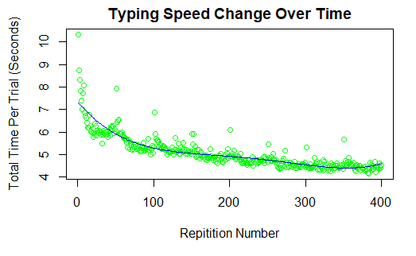
Graphing the Model | Polynomial Regression
Visual takeaways
Change in slope over time
Line cuts through a vast majority of data
Flattening of the curve

Slide 8
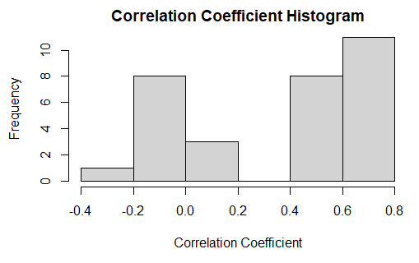
Additional Thoughts
Correlation of each variable to average speed
Each variable could roughly be placed into two categories as it relates to correlation
Somewhat correlated (ie. a correlation coefficient between .5 and.8)
No correlation (ie. cc between -.2 and .2)

Slide 9
Conclusion
Typing speed tends to increase over time, however, it will see diminishing returns
The largest speed increase will be seen in the first 100 trials
Even with time and repetition, some aspects are typing do not change over the course of practice

